Slide 1
ITEC100 – Week 6 Excel Associate 365 Review 1 Testing
Tutor: Dr. Farshid Keivanian

Slide 2
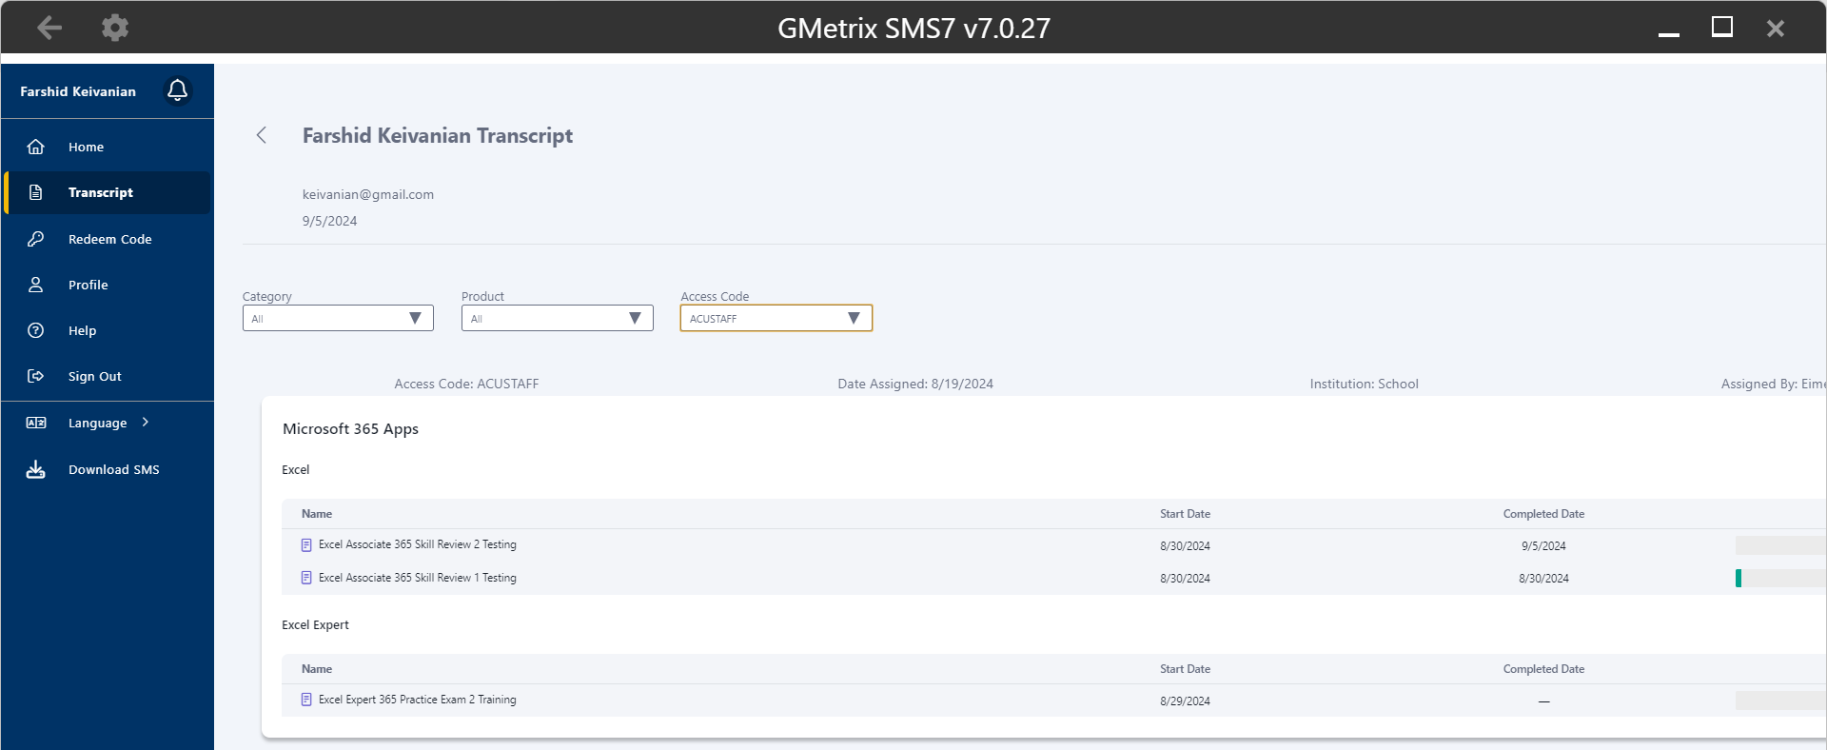
Excel Associate 365 Review 1

Slide 3
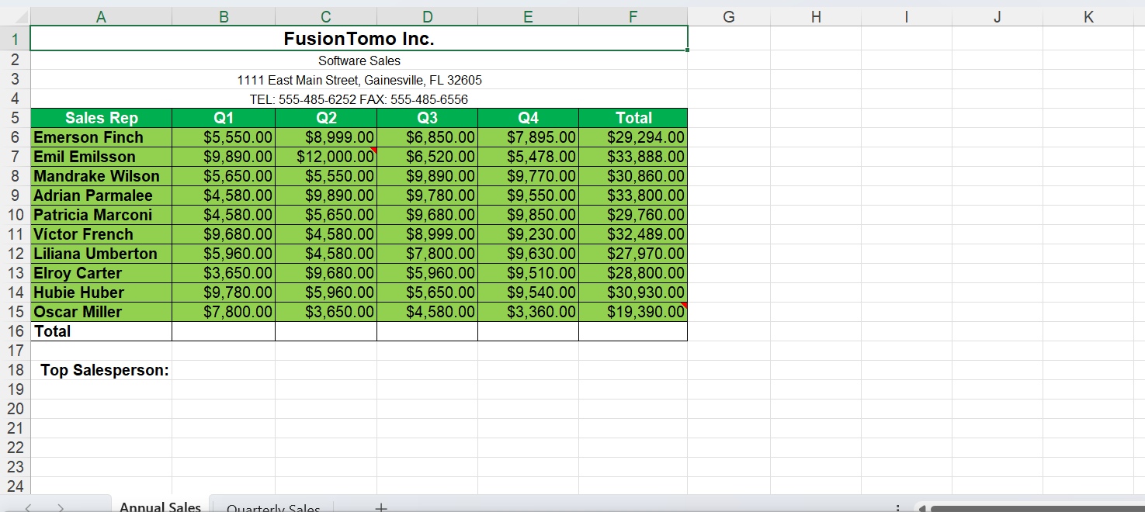
Excel Associate 365 Review 1
In the Annual Sales worksheet, use the Find & Select tool to find the cell in the open spreadsheet that contains Conditional Formating and apply a Thick Outside Border.

Slide 4
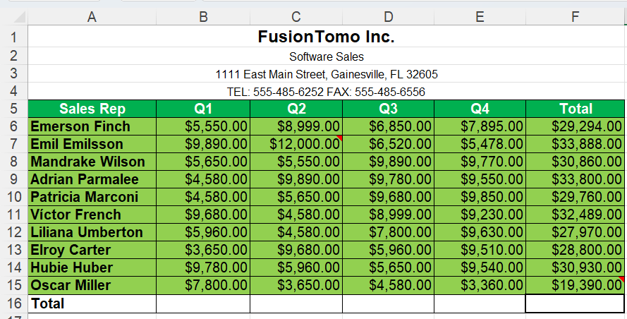
Excel Associate 365 Review 1
1. Go to the "Annual Sales" Worksheet:
Click on the tab named "Annual Sales" at the bottom of the Excel window.
2. Use the Find & Select Tool:
On the Ribbon, go to the Home tab.
In the Editing group, click on Find & Select.
From the drop-down menu, select Conditional Formatting.
3. Find the Cell with Conditional Formatting:
Excel will highlight the cell(s) that contain Conditional Formatting. This is the cell you need to modify.

Slide 5
Excel Associate 365 Review 1
4. Apply a Thick Outside Border:
With the cell selected, go to the Home tab.
In the Font group, click on the drop-down arrow next to the Borders icon.
From the list, select Thick Outside Borders.
5. Save Your Work:
Save the Excel file by pressing Ctrl + S or by clicking on the Save icon.

Slide 6
Excel Associate 365 Review 1
Use the AutoSum tool to get the SUM of the values for each cell (B through F) in the Total row.

Slide 7
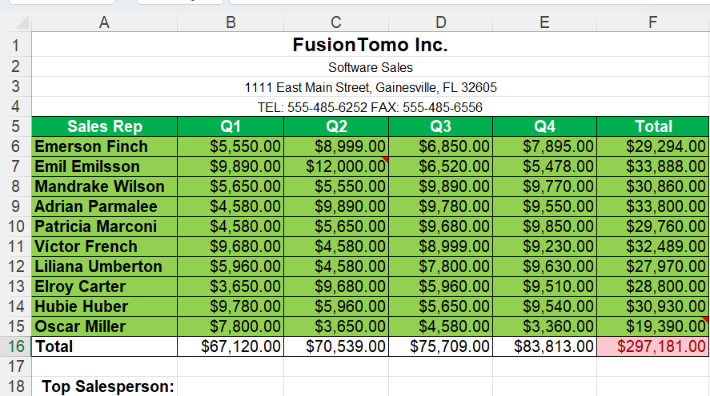
Excel Associate 365 Review 1
1. Select the Cell in the Total Row (Column B):
Click on cell B16 (the cell directly below the Q1 column values in the Total row).
2. Use the AutoSum Tool:
While cell B16 is selected, go to the Home tab on the Ribbon.
In the Editing group, find and click the AutoSum button (Σ symbol).
Excel will automatically select the range of cells above it (B5 through B15). Press Enter to confirm the sum.

Slide 8
Excel Associate 365 Review 1
3. Repeat for Columns C through F:
Repeat the above steps for each of the following cells: C16, D16, E16, and F16.
For each cell, select the corresponding cell in the Total row and use the AutoSum tool to calculate the sum of the values above it.
4. Review the Results:
After performing these steps, cells B16 through F16 should display the total sums for each respective column.

Slide 9
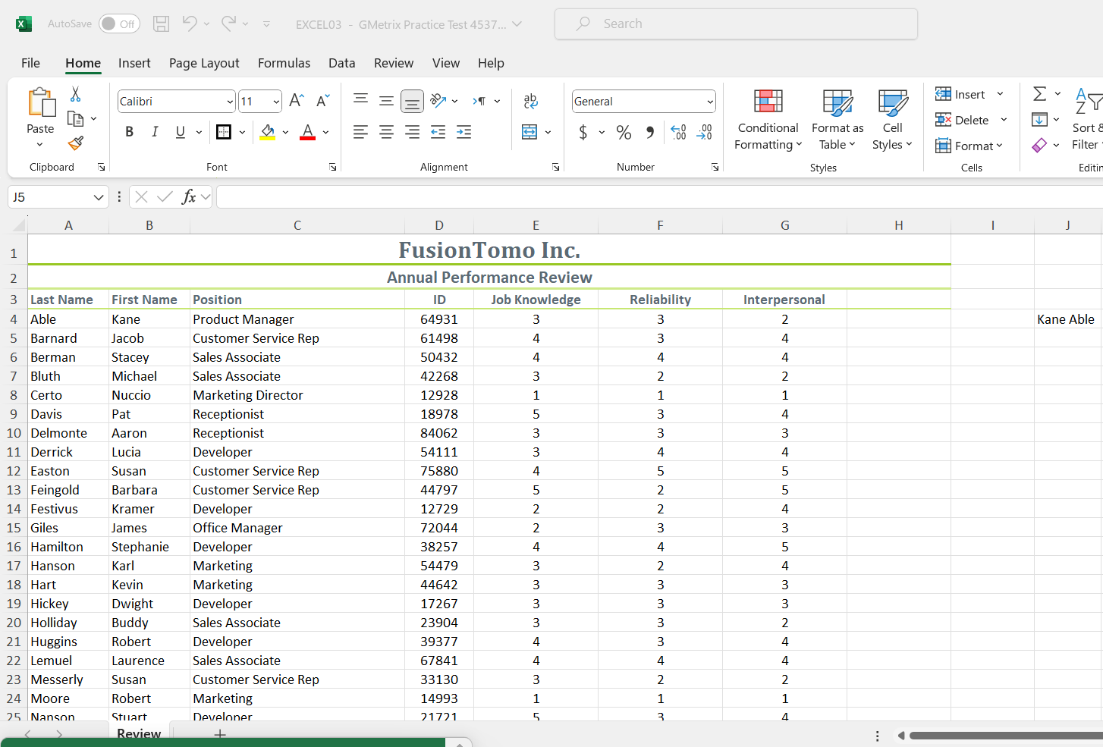
Excel Associate 365 Review 1
In the Review worksheet, use the CONCATENATE function to display the contents of cell B4 and A4 separated by a space in cell J4.
1. Select Cell J4:
Click on cell J4 in the "Review" worksheet.
2. Enter the CONCATENATE Function:
In cell J4, enter the following formula:
excel
= CONCATENATE(B4, " ", A4)
This formula combines the content of cell B4 and cell A4, with a space (" ") between them.

Slide 10
Excel Associate 365 Review 1
In the Review worksheet, use the CONCATENATE function to display the contents of cell B4 and A4 separated by a space in cell J4.
3. Press Enter:
After typing the formula, press Enter.
The result in cell J4 should now display the content of B4 and A4 separated by a space.
Explanation:
The CONCATENATE function is used to join two or more text strings into one string.
" " adds a space between the content of B4 and A4.

Slide 11
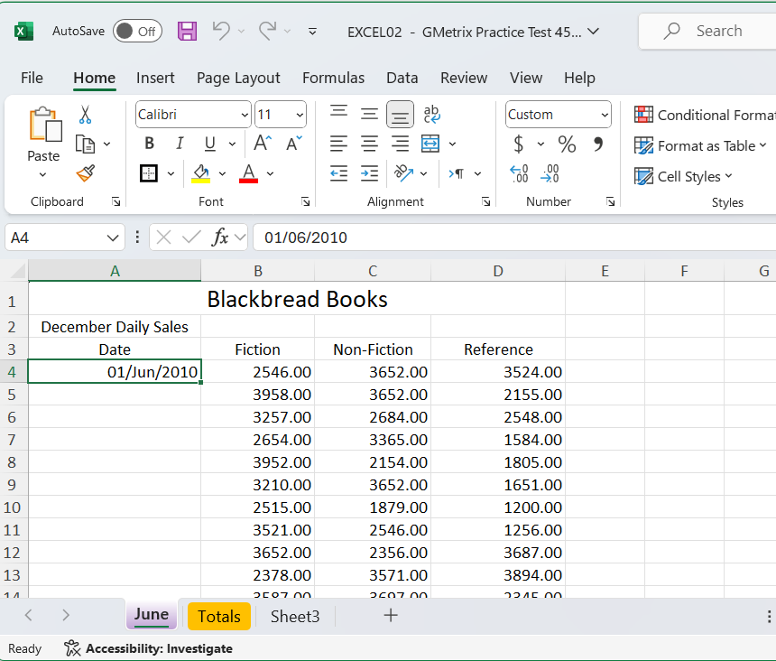
Excel Associate 365 Review 1
In the June worksheet, use Autofill to extend the series starting in the cell A4 to the cell A33.
1. Select the Starting Cell:
Click on cell A4, which contains the date "01/Jun/2010."
2. Use the Autofill Handle:
Move your cursor to the bottom-right corner of cell A4 until it changes to a small black cross (this is the Autofill handle).

Slide 12
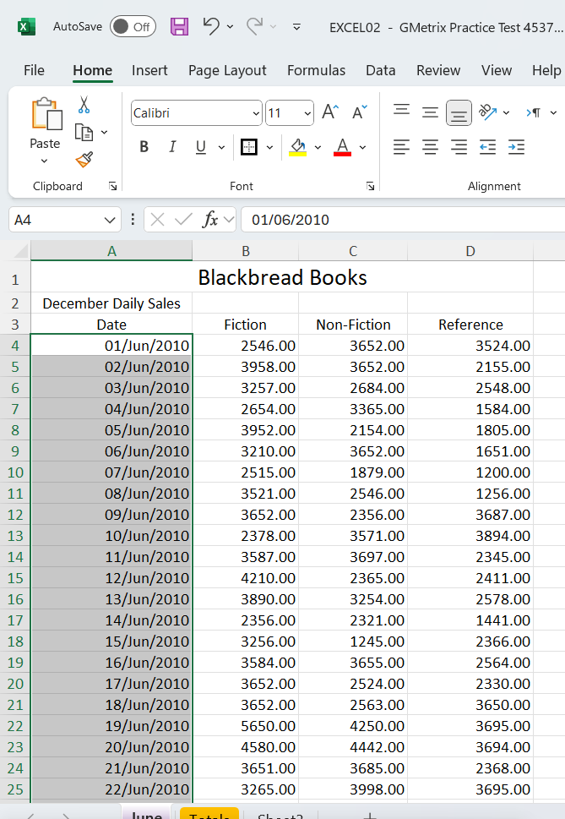
Excel Associate 365 Review 1
In the June worksheet, use Autofill to extend the series starting in the cell A4 to the cell A33.
3. Drag Down to Extend the Series:
Click and hold the left mouse button on the Autofill handle and drag it down to cell A33.
As you drag down, Excel will automatically fill in the dates in sequence.
4. Release the Mouse Button:
Once you reach cell A33, release the mouse button. The dates should now be filled in, continuing the series from A4.

Slide 13
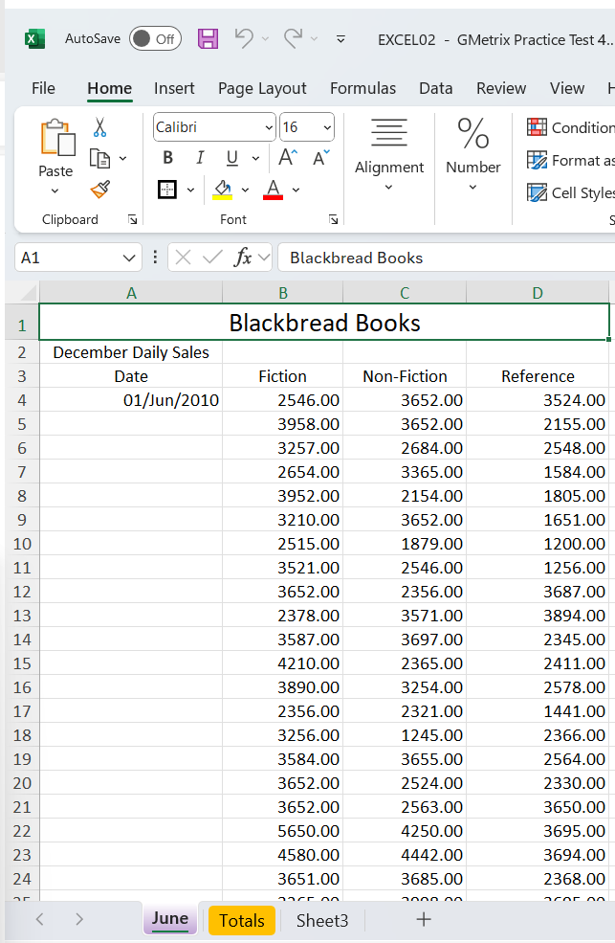
Excel Associate 365 Review 1
In the June worksheet, apply Table Style Light 4 to the cells A3 through D34.
1. Select the Range of Cells:
Click and drag to select the cells from A3 to D34 in the "June" worksheet.
2. Convert the Range to a Table:
Go to the Insert tab on the Ribbon.
Click on Table. Excel will automatically detect the range you've selected.
Ensure the checkbox for My table has headers is checked since your selection includes headers in row 3 (Date, Fiction, Non-Fiction, Reference).
Click OK to convert the range to a table.

Slide 14
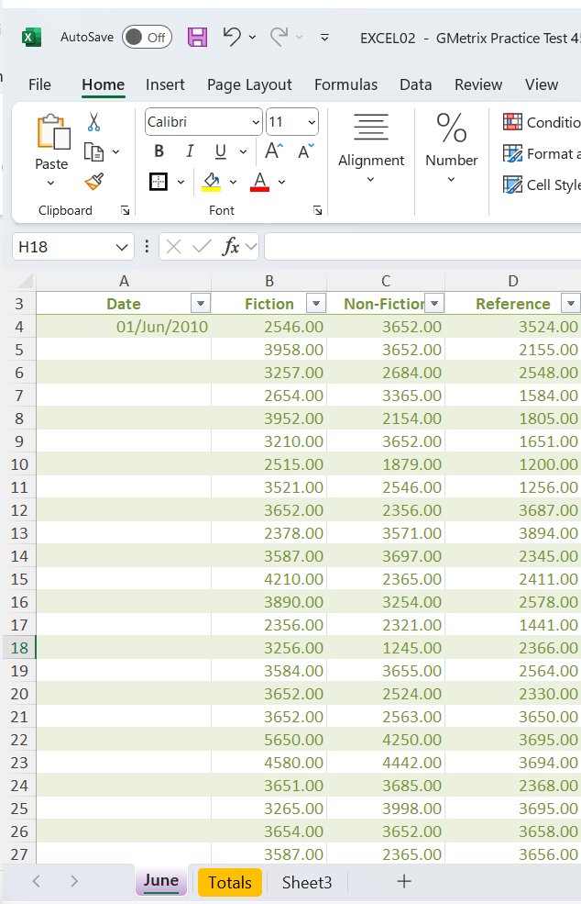
Excel Associate 365 Review 1
In the June worksheet, apply Table Style Light 4 to the cells A3 through D34.
3. Apply Table Style Light 4:
With the newly created table still selected, go to the Table Design tab on the Ribbon (this tab appears only when the table is selected).
In the Table Styles group, click the drop-down arrow to see more styles.
Scroll through the list of styles and select Table 4 Style Light 4.
4. Review the Table:
Your selected range should now be formatted using the "Table Style Light 4" style, with alternating light-colored rows and formatted headers.

Slide 15
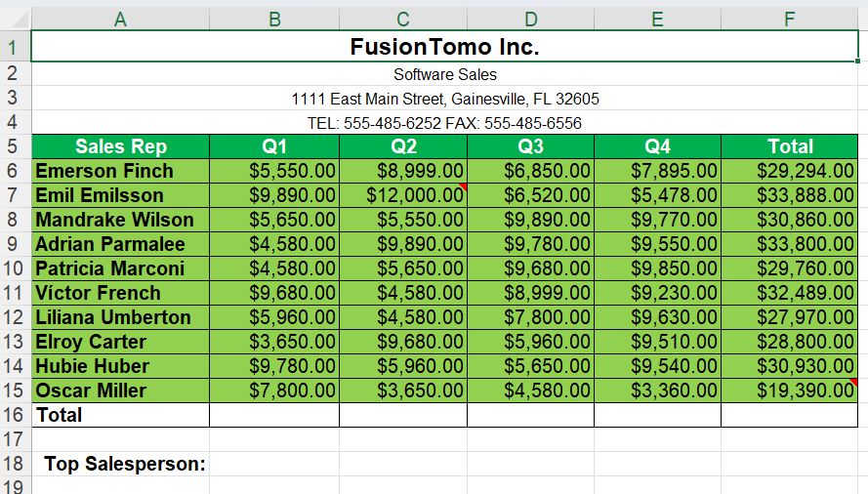
Excel Associate 365 Review 1
In the Annual Sales worksheet, apply a Link to the title FusionTomo Inc. that links to the website www.fusiontomo.com
3. Apply Table Style Light 4:
With the newly created table still selected, go to the Table Design tab on the Ribbon (this tab appears only when the table is selected).
In the Table Styles group, click the drop-down arrow to see more styles.
Scroll through the list of styles and select Table 4 Style Light 4.
4. Review the Table:
Your selected range should now be formatted using the "Table Style Light 4" style, with alternating light-colored rows and formatted headers.

Slide 16
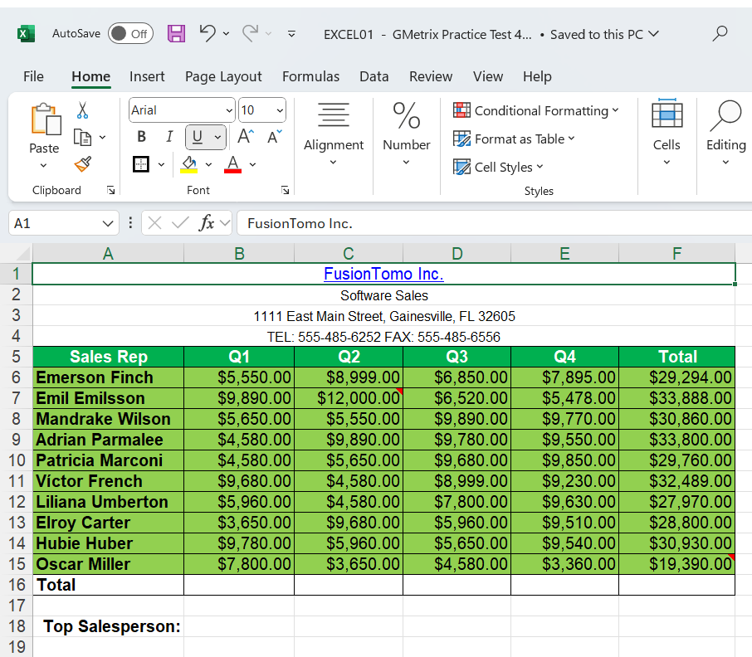
Excel Associate 365 Review 1
In the Annual Sales worksheet, apply a Link to the title FusionTomo Inc. that links to the website www.fusiontomo.com
1. Select the Cell Containing the Title:
Click on cell A1 where the title "FusionTomo Inc." is located.
2. Insert the Hyperlink:
Right-click on cell A1 and select Link from the context menu. Alternatively, you can go to the Insert tab on the Ribbon and click on Link.

Slide 17
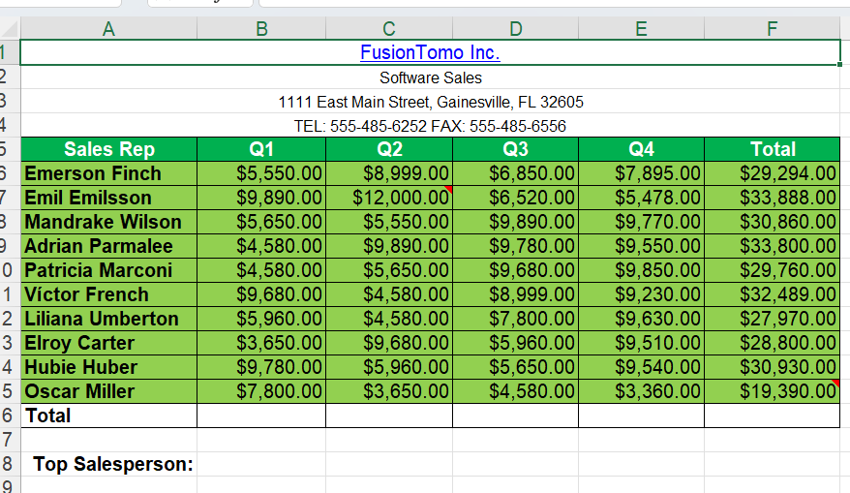
Excel Associate 365 Review 1
In the Annual Sales worksheet, apply a Link to the title FusionTomo Inc. that links to the website www.fusiontomo.com
3. Add the Website URL:
In the dialog box that appears, type the URL http://www.fusiontomo.com in the Address field.
Ensure that the Text to display field shows "FusionTomo Inc."
4. Confirm and Apply:
Click OK to apply the hyperlink.

Slide 18
Excel Associate 365 Review 1
In the Annual Sales worksheet, apply a Link to the title FusionTomo Inc. that links to the website www.fusiontomo.com
5. Verify the Link:
The title "FusionTomo Inc." in cell A1 should now be a clickable hyperlink that takes you to www.fusiontomo.com when clicked.

Slide 19

Submit the Excel Associate 365 'Skill Reviews 1 and 2. Make sure your name, data, and score is visible in the screenshots.
Thank you
Dr. Farshid Keivanian

